Slide 1

Using EWS Managed API 2.2 in PowerShell
Chendrayan Venkatesan (Chen V)
@ChendrayanV

Slide 2

Why EWS API? Why not native Exchange Online cmdlets?

Slide 3
Inspired from……..
We Offer THREE kinds of service
GOOD-CHEAP-FAST
Pick any two
GOOD service CHEAP won’t be FAST
GOOD service FAST won’t be CHEAP
FAST service CHEAP won’t be GOOD
___________________________________________
☺ ☺ ☺

Slide 4
Agenda
API Introduction
EWS Architecture and Overview
EWS Managed API
Benefits of Using EWS Managed API in PowerShell
Get-Started
Demo

Slide 5
API Introduction
Application Programming Interface
An Engine Under the Hood.
A messenger to convey our needs to system to get the job done!
Is a set of subroutine definitions, protocols and can be a tool for building applications.
A good API allows us to interact with a system in very easy manner.
It’s required for both IT Professionals and developers to work in any infrastructure for solving customer requirements.

Slide 6
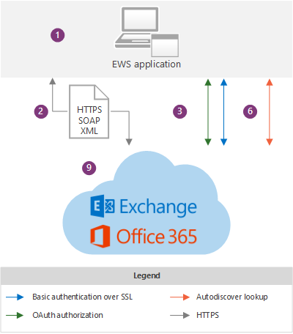
EWS Application and Exchange Online Architecture
Client, Portal and Service

Slide 7
EWS Overview
Open Standards-based protocol
XML/SOAP/WSDL-based Web Service
Implements Exchange/Outlook business logic
Strongly typed access
Message/tasks/contacts/calendar/folders
Workflow
Free/busy
Suggested meeting times
Accepting/sending/updating meeting requests
Delegation and permissions
Replying to messages
Notifications
Synchronization

Slide 8
EWS Managed API
EWS Managed API is a custom web service client and a standard client access API for .NET Framework
Intuitive object model.
Abstracts the complexities of the service description in the WSDL and schema files.
Includes client-side business logic.
Handles Web Requests and Responses.
Object Serialization and De-Serialization

Slide 9
Benefits of Using EWS Managed API in PowerShell
Easy to solve operational issues and to meet requirements.
$Object Oriented Design.
Smart Client Features and AutoDiscover is built-in.
Same code for Cloud and On Premises.
Readability and easy to manage the code, enhance, distribute etc.

Slide 10
PS C:\> Get-Started
Microsoft Exchange Web Services Managed API 2.2 Documentation
Microsoft Exchange Web Services Managed API 2.2
Install the EWS API 2.2 (Click – Click – Click Installation!)
Default Location – “C:\Program Files\Microsoft\Exchange\Web Services\2.2”
Make use of ReadMe.Html ☺ ☺ ☺

Slide 11
Folder Hierarchy
Folder
CalendarFolder
ContactFolder
TaskFolder
SearchFolder

Slide 12
Item Class Hierarchy
Item
Appointment
Contact
Task
Meeting Message
PostItem
MeetingRequest
MeetingResponse
MeetingCancellation
EmailMessage

Slide 13
Code @ Ease
Choose your favorite editor and don’t compromise.
In our case we use VS Code, PowerShell ISE or VS with PowerShell Extension
Search for the scripts in PowerShell Gallery, TechNet Script Gallery or in GitHub! If available modify it for your needs!
Include help documents or inline comments for your code to help others.
Avoid jargons in your comments and keep the code clean.

Slide 14
Demo
Get-xTask
Get-xCalendarInformation
Get-xJunkEmail
Get-xPhoneAlert
New-xAppointment
New-xTask
New-xMeeting

Slide 15
PS C:\> WhoAmI
Chendrayan Venkatesan (Chen V)
CDM MVP | MCTS SharePoint | MCP Exchange | ITIL V3 Foundation
Twitter : @ChendrayanV
LinkedIn : https://www.linkedin.com/in/chendrayanv/
An IT Professional one who use PowerShell at workplace! Strongly believe in the saying “Learning is a continuous process!”

